Slide 1

Plant Pals
Customer Survey Results
We surveyed 50 Plant Pals test batch customers over a four-week period to learn about their satisfaction with the product, delivery process, and customer support.

Slide 2
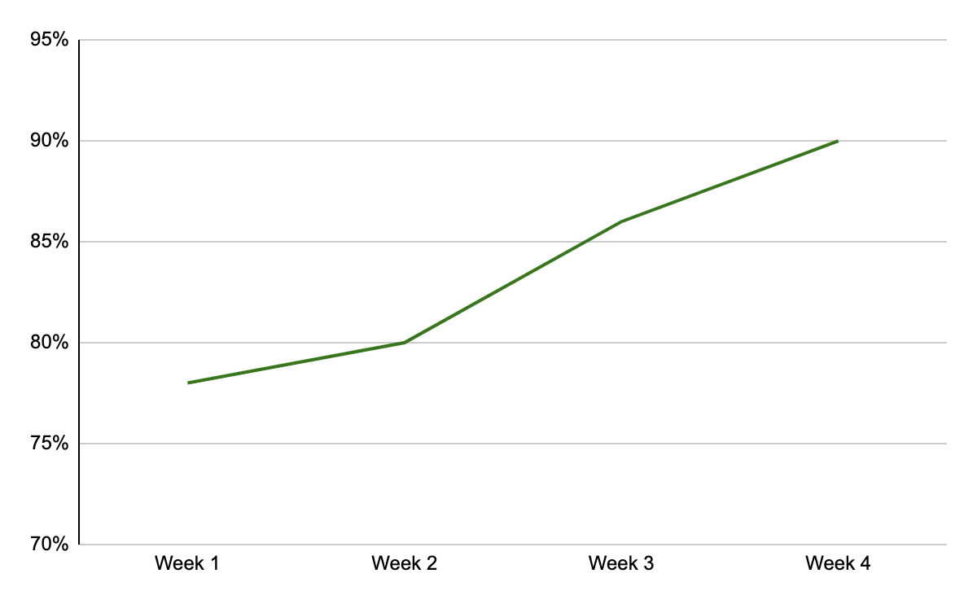
Did your shipment arrive on time?
[Insert chart or graph here]
Key takeaways & action items: On-time deliveries rose to 90% by the end of the survey—a solid improvement, but still short of our 95% target. Investigate additional reasons for late deliveries.

Slide 3
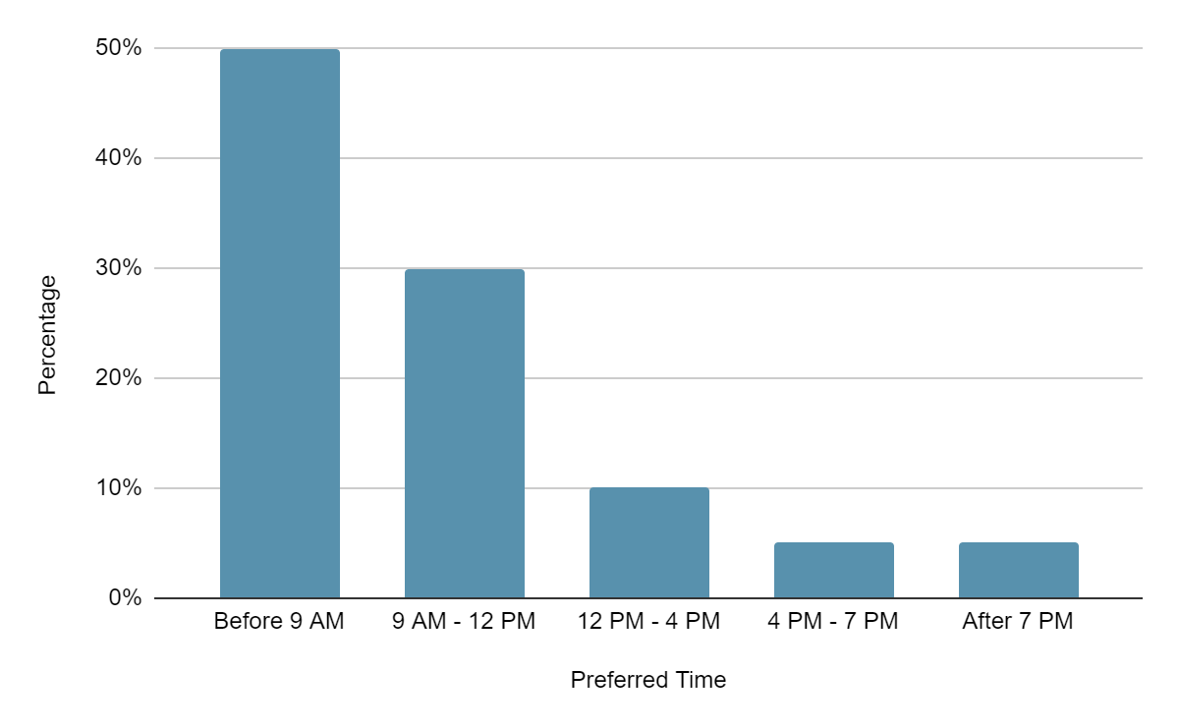
What is your preferred time of day to receive a shipment from Plant Pals?
[Insert chart or graph here]
Key takeaways & action items: Customers overwhelmingly prefer deliveries before normal business hours and early in the day. Consider scheduling more early delivery routes, which could help raise successful, on-time deliveries to 95%.

Slide 4
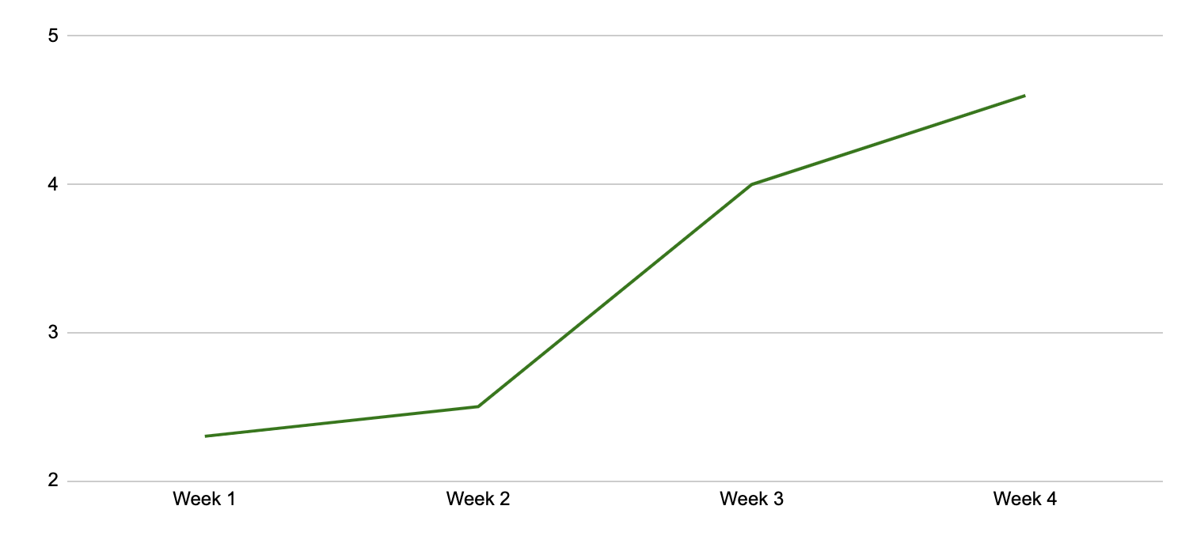
On a scale of 1 to 5, with 1 being the lowest and 5 being the highest, how satisfied are you with customer support?
[Insert chart or graph here]
Key takeaways & action items: Satisfaction with support increased once we fixed the customer service software problem. There is still room for improvement, so continue to monitor responses and solutions to support tickets.

Slide 5
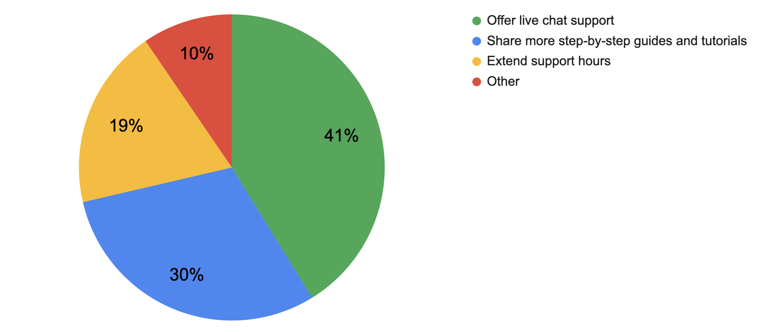
In general, how do you suggest we improve our customer support?
[Insert chart or graph here]
Key takeaways & action items: A number of customers volunteered that a live chat option would improve customer support. Also, many respondents found the guides and tutorials helpful. Research expanding these offerings for specific plant species.

Slide 6
Conclusion and next steps

